Slide 1


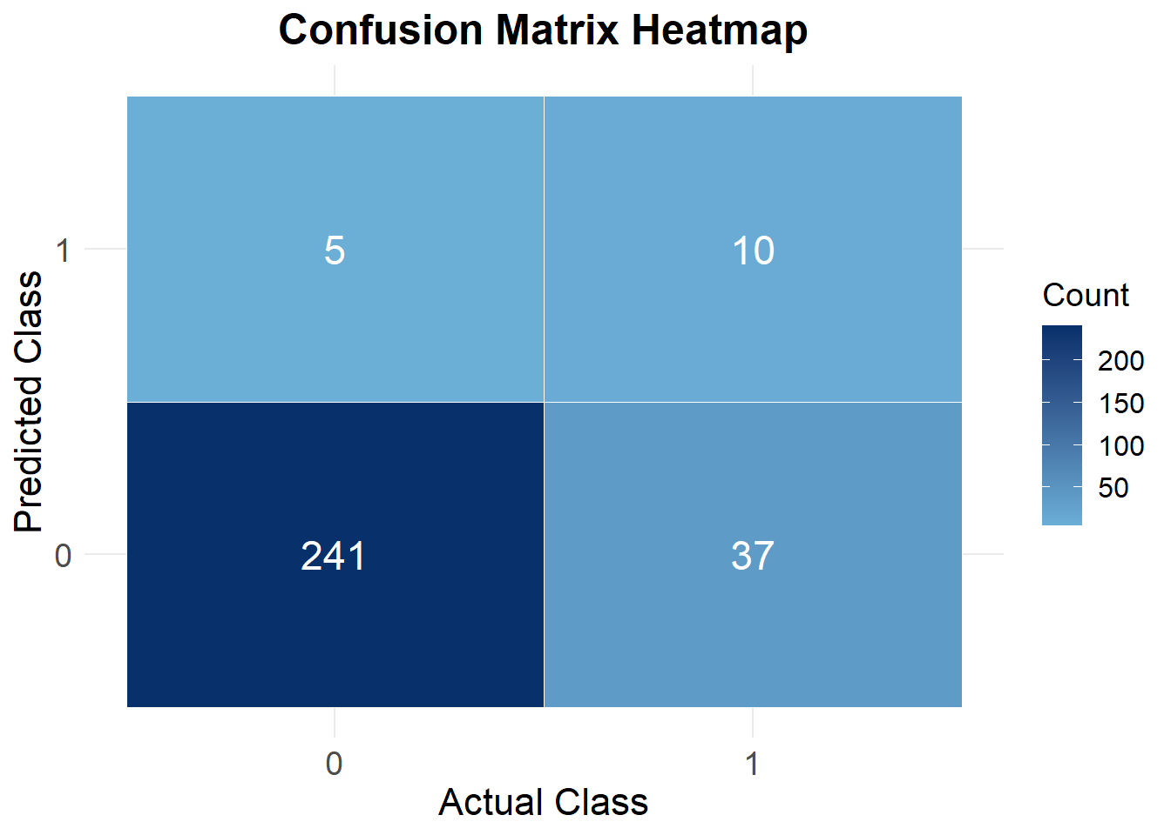
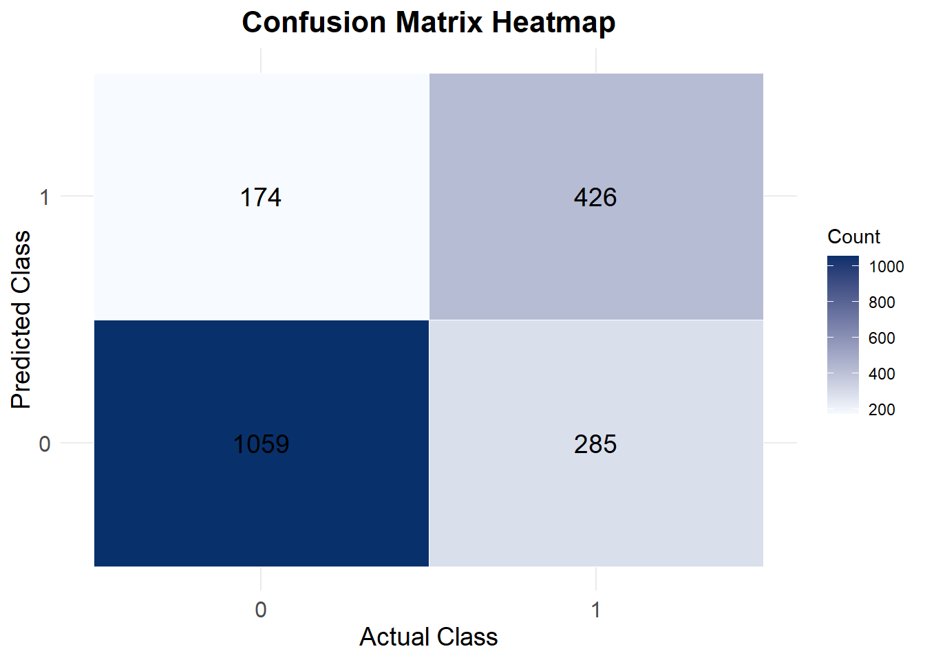
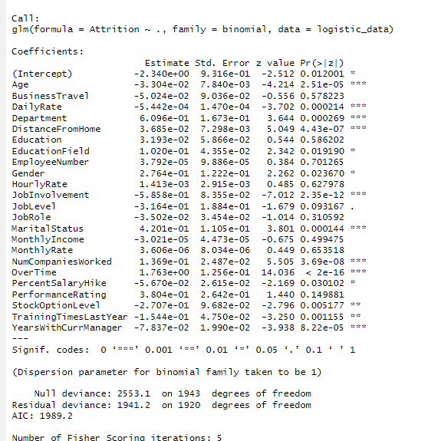
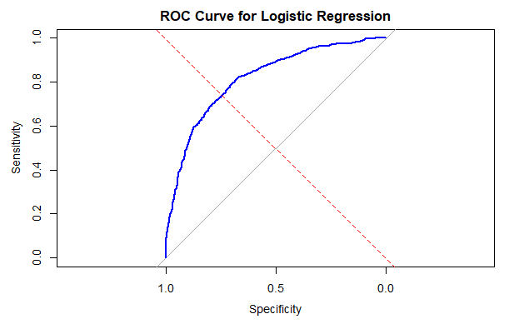
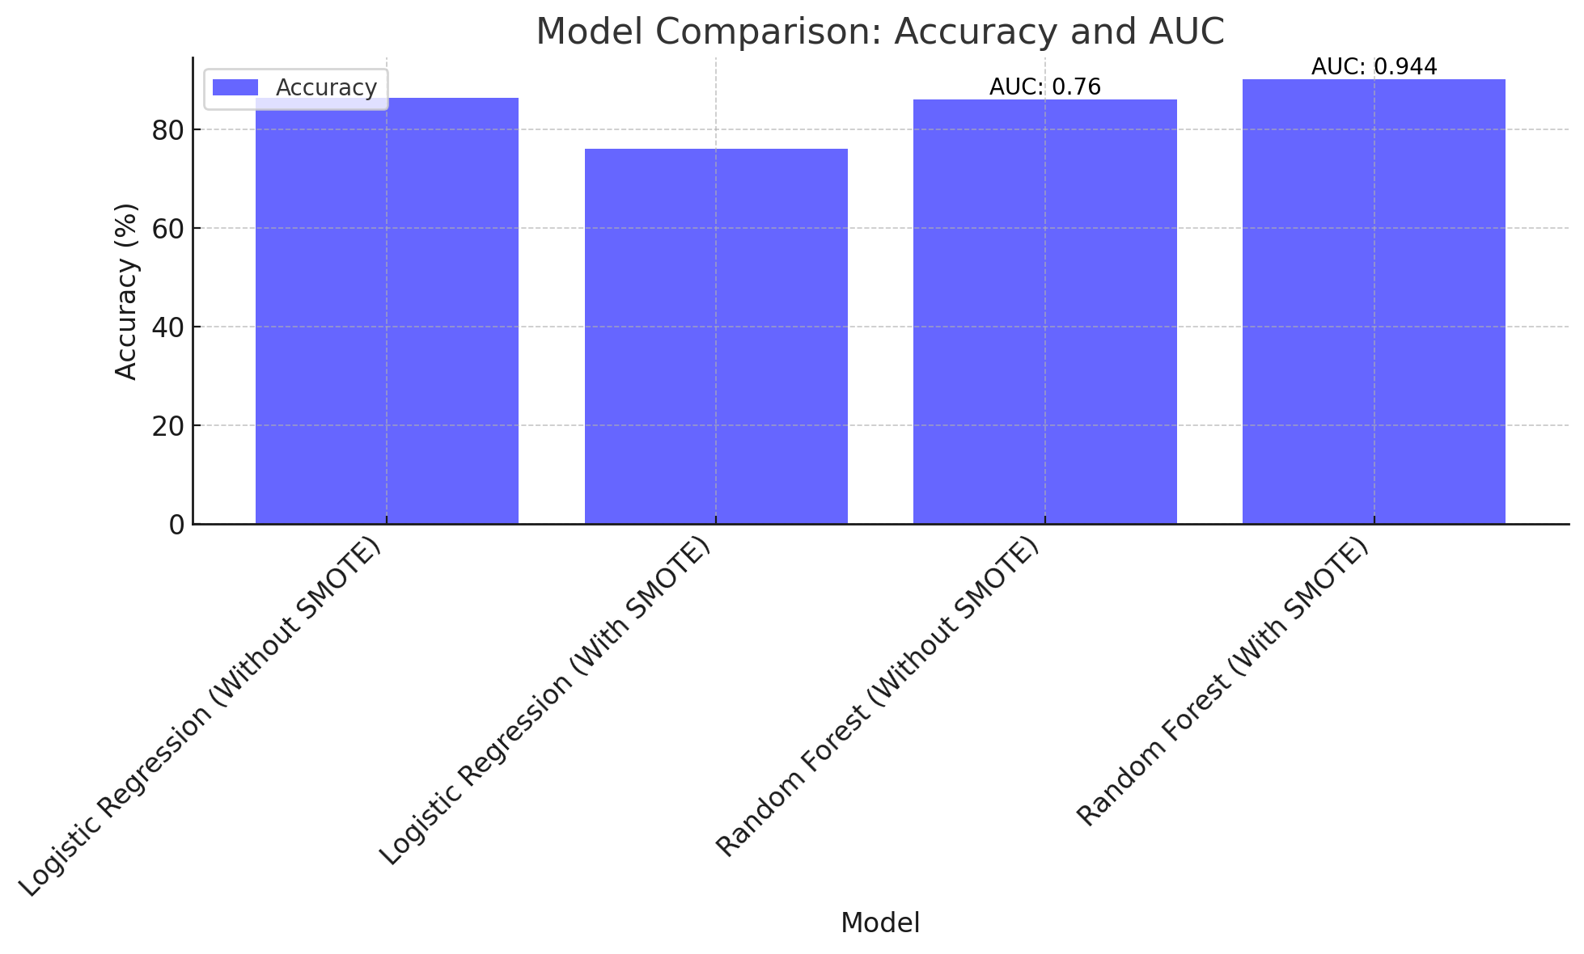
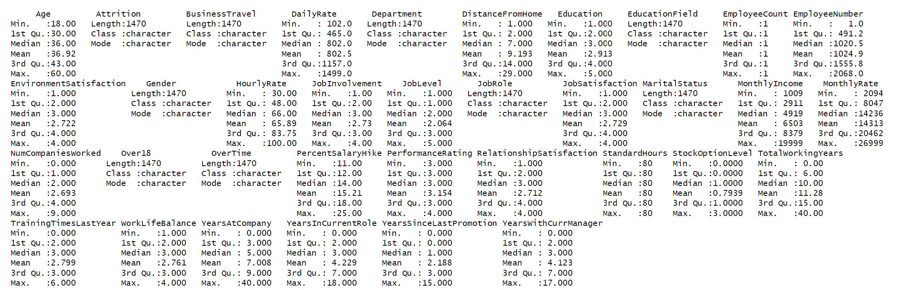
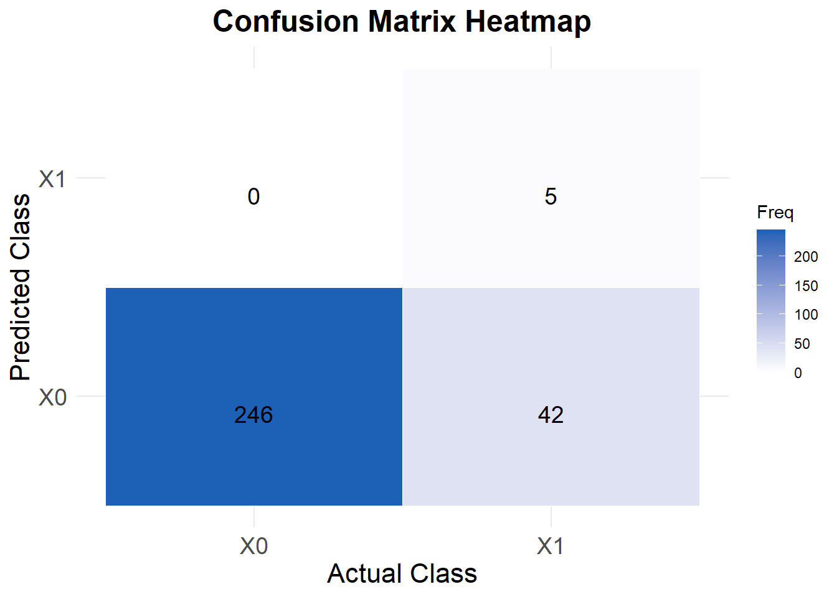
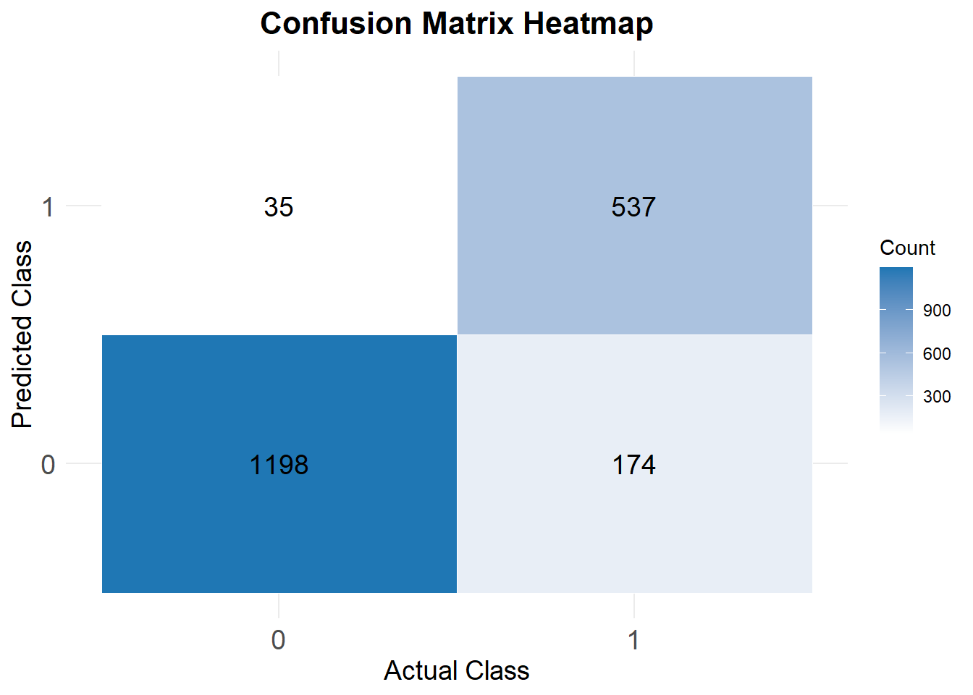
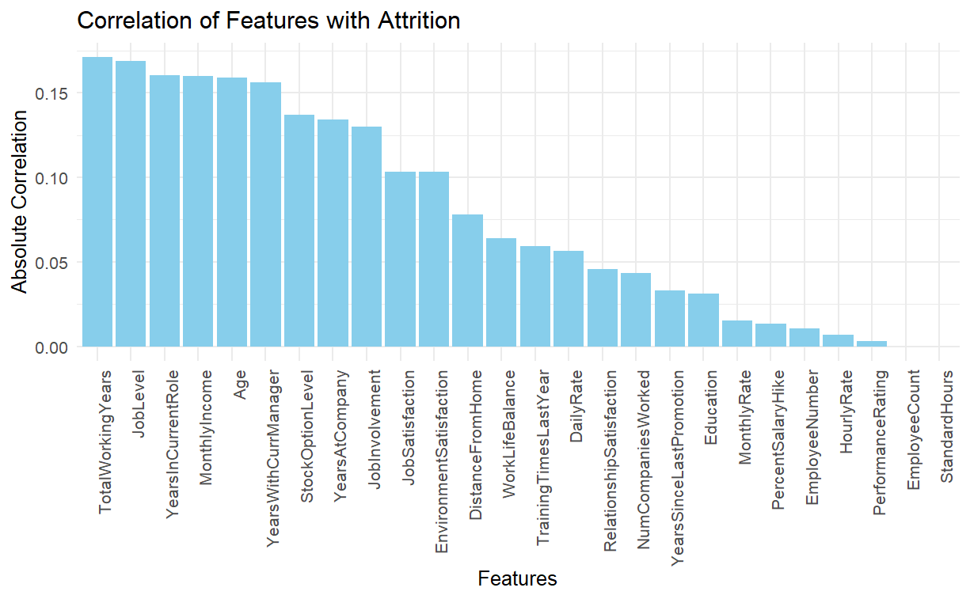
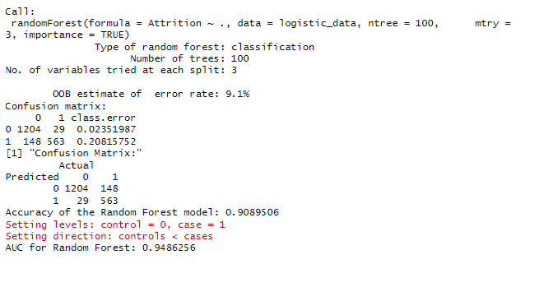
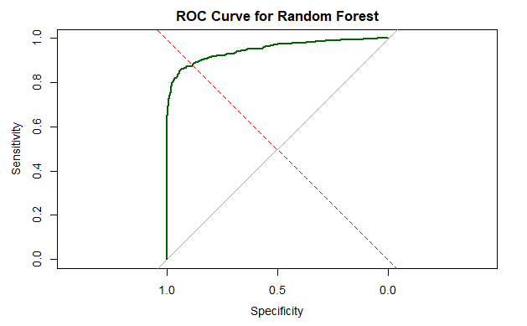
Predicting Employee Attrition with Machine Learning and Analytics Team – Vinay Vaida Department of Mathematics and Statistics - University at Albany, State University of New York
INTRODUCTION
MODEL BUILDING
CONCLUSION
A company aims to enhance employee retention by analyzing attrition patterns using data-driven insights. Key details like Age, Department, Job Role, Income, Distance, Overtime, and Satisfaction are evaluated to identify factors driving turnover. This analysis helps predict employees at risk of leaving, enabling targeted retention strategies to improve workforce stability and reduce turnover costs
Data Set Attributes
The dataset consists of 1470 records and 35 attributes, capturing various aspects of employee demographics, job roles, and workplace satisfaction. Key features include Age, Gender, Department, Job Role, Marital Status, Monthly Income, Distance from Home, Job Satisfaction, and Overtime. The target variable, Attrition, indicates whether an employee has left the company, helping to identify patterns and predictors of turnover.
Implemented various machine learning algorithms such as logistic regression and random forests to predict employee attrition. Applied SMOTE (Synthetic Minority Over-sampling Technique) to balance the dataset, allowing for a comparative analysis of model performance with and without SMOTE. Utilized appropriate feature selection and engineering techniques to enhance model accuracy and improve the prediction of employees at risk of leaving.
Conclusion: Evaluating Model Performance with and without SMOTE Logistic Regression: The logistic regression model without SMOTE achieved an accuracy of 86.39% and moderate AUC, struggling to effectively identify the minority class ("1"). Specificity remained low, indicating difficulty in distinguishing attrition cases. After applying SMOTE, the model showed improved balance between sensitivity and specificity, with better identification of the minority class. However, the overall accuracy dropped slightly to 76.03%, reflecting the trade-off of focusing on balanced performance. Random Forest: Without SMOTE, the Random Forest model demonstrated excellent performance, achieving an accuracy of 90.12% and a high AUC of 0.944. It excelled in identifying the majority class ("0") but faced moderate challenges with the minority class ("1"). With SMOTE, the model maintained the same accuracy and AUC, while improving its ability to predict the minority class effectively, striking a balance between sensitivity and specificity. Comparison and Key Insights: Between the models, Random Forest consistently outperformed Logistic Regression, with or without SMOTE, due to its ability to handle complex relationships and interactions in the data. The application of SMOTE enhanced the performance of both models in identifying the minority class, but Random Forest with SMOTE emerged as the best overall, achieving high accuracy and near-perfect AUC.
LOGISTIC REGRESSION
Logistic Regression
SMOTE MODEL
SMOTE was applied to balance the dataset, improving the logistic regression model's performance in identifying the minority class. The model demonstrated improved sensitivity across both training and test datasets. However, a slight decrease in specificity was observed, indicating potential trade-offs due to oversampling. Random forest was then utilized on the SMOTE-balanced dataset to enhance overall model performance, effectively addressing class imbalance and providing a better balance between sensitivity and specificity.
ROC curves using SMOTE
Analysis to understand distribution of variables within data set
Exploratory Data Analysis
RANDOM FOREST
ROC Curve using SMOTE
Random Forest SMOTE MODEL
REFERENCES
Reference:
Almutairi, M., et al. “Predicting Employee Attrition Using Machine Learning Approaches.”
Shams-Gharneh, N., et al. “An Improved Machine Learning-Based Employees Attrition Prediction Framework.”
Galán Hernández, J. J., et al. “Analyzing Employee Attrition Using Explainable for Strategic HR Decision-Making.”
Contact:
vvaida@albany.edu

